Slide 1

E- Booking Portal For Books

Slide 2

Project Scope
E-Booking portals for books were introduced to meet the changing preferences and lifestyles of readers, driven by advancements in technology.
E-Booking portal offers readers the convenience of providing the availability of library books ,this eliminates the need to visit library every time and wait for the book.

Slide 3
About the project
We can typically reserve a copy of a book that is not yet released or is currently out of stock by pre-booking it.
It will be notified once it is available.
This allows us to secure or book a copy in advance.

Slide 4
Working
We begin by browsing the book that we want in the library’s catalogue to check it’s availability.
If the book is not currently available or booked by somebody else ,we can inquire about pre-booking or reserving it.
We can pre-book the book by entering our user id which will notify us when the book becomes available .

Slide 5
Once we reserved the book ,we will be placed on a waiting list .
When the copy of book becomes available, the library will notify us based on priority order through our contact details or a notification system.
After receiving the notification , you can go to the library and pick our book.
We should be aware the libraries provide a limit time to pick the book. If we don’t take the book it will be offer to next person on the waiting list.

Slide 6
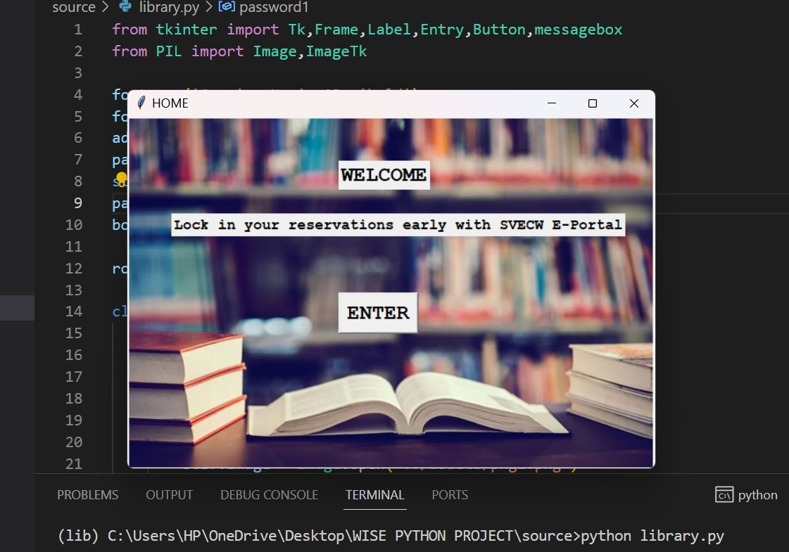
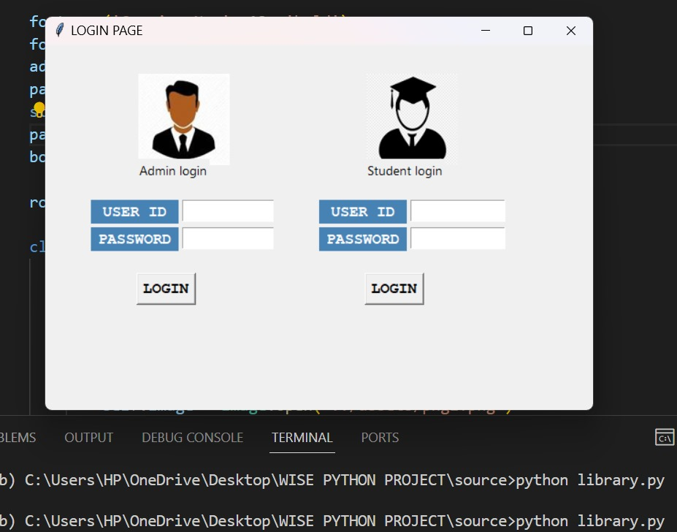
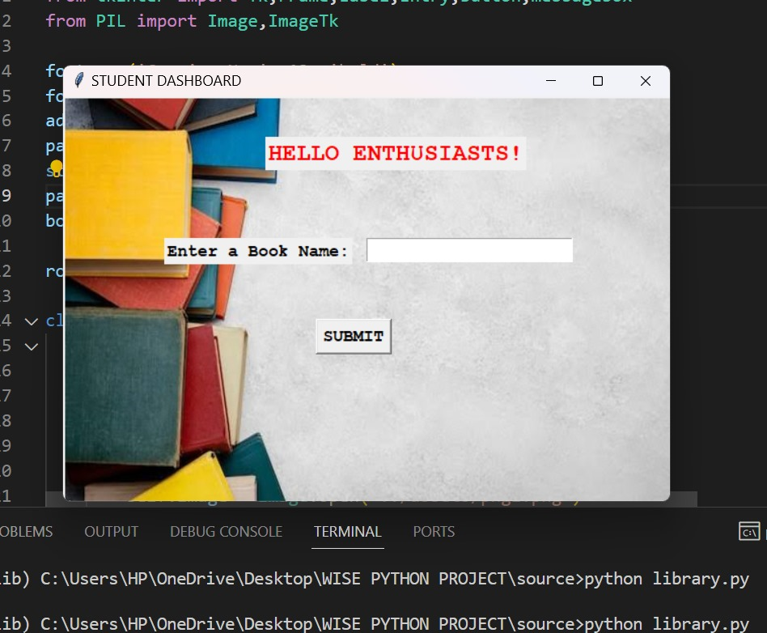

Slide 8
Uniqueness
With pre-booking we can secure a copy of book by ensuring that we will have access to it when it becomes available.
It’s convenient way to reserve the books without having to visit the library frequently.
Pre-booking prioritizes patrons who have reserved a book.

Slide 9
Libraries can efficiently manage their inventory and reduce the situations of books being lost or misplaced.
We can plan your library visits more efficiently.

Slide 10
Overall, our pre-booking method adds a layer of convenience, certainty, and fairness to the borrowing process, benefiting both library patrons and the library itself in managing its collection…

Slide 11

THANK YOU
“ A Book is a gift that you can open again and again…”

